Slide 1
Taxes in Finland

Slide 2
Keywords
Taxes — payments you must make
to the government to finance welfare services.
Withholding rate — the part of your wages
that your employer withholds from your pay,
and sends on to the Finnish Tax Administration.
Finnish Tax Administration — the organisation
that gathers the payments and
gives advice on tax questions.

Slide 3
Keywords (continued)
Pre-completed tax return — a report with
information on your income and deductions
during the year.
Tax decision — the result of the calculation
of your income, tax, and deductions for the year.
You may get money back (a refund), or
you may have to pay more (back taxes).
Earned income — your pay, wages, salary etc.
Progressive taxation — the rule that makes the
tax rate higher when the income is higher.

Slide 4
How is the money used?
With tax money, Finland pays for:
health care and medical care
schools
children's daycare
higher education
national defence
facilities for sports, arts and hobbies.

Slide 5
You are a taxpayer, too:
  When you buy something, prices include
  Value-Added-Tax (VAT).
You pay income tax when you work and get paid.
You also pay income tax for:
  Students' grant income
  Pension income
  Unemployment allowance
  Business income.
If you get rental income and if you get dividends,
you pay income tax on capital income.
Notes:
Makeisvero: Verotuksella pyritään ohjaamaan kuluttajien käyttäytymistä. Ylimääräisellä verolla halutaan vähentää tuotteen ostamista ja samalla kerätä lisää verotuloja. Muita kulutusta ohjaavia veroja: Alkoholivero, tupakkavero, polttoainevero

Slide 6

Tax Calendar
January:
You get a new
tax card.
You get income during
the year, and part of it
is paid in (tax withholding).
2019
2020
April:
You get a Pre-completed
tax return – check it and make corrections,
if necessary.
September and October:
You get a new Tax Decision
if you made corrections
in April.
December:
You may get a refund OR you may have to pay back taxes.

Slide 7

Tax cards
2019
Everyone must have a tax card
(for receiving wages or other income).
It has the withholding rate printed on it. This tells your employer
how much to withhold.
Your get a new tax card
sent to you every year
in January.

Slide 8
Tax cards (continued)
2019
Ask for a new tax card if
your income changes
during the year.
  Tax Card Online (tax.fi/taxcard)
  Telephone Service on 020 697 000.
  Visit any Tax Office.

Slide 9
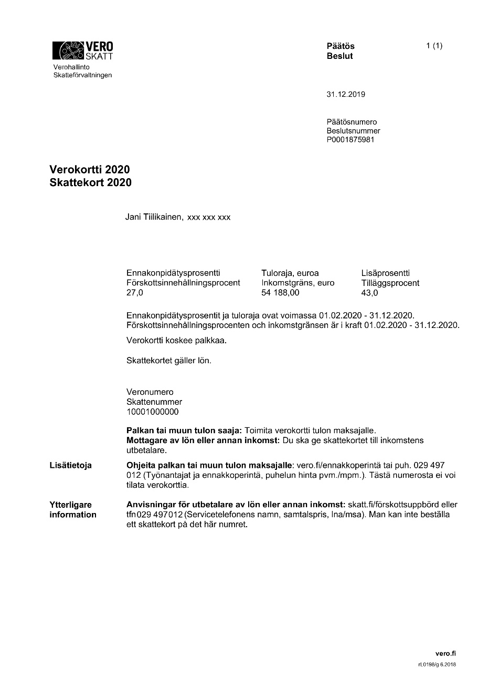
The tax card looks like this:
If you earn more than your income ceiling, your employer withholds tax according to the additional withholding rate.
The withholding rate
= how much
money your employer withholds.
Wages and holiday bonuses are included in the income ceiling. Follow how much you earn and change your tax card, if necessary.

Slide 10

Pre-completed tax return
2020
You get a pre-completed tax return every year, in spring. We send it by post.
It shows your income
and deductions
as we know them.
It also shows a first calculation of your
taxes for the year:
will you get a refund, or will you
have to pay more.

Slide 11
Pre-completed tax return
2020
You must check the information.
If any of the details are wrong,
make corrections and send
them to us.
If the information is correct,
you don't have to do anything.

Slide 12
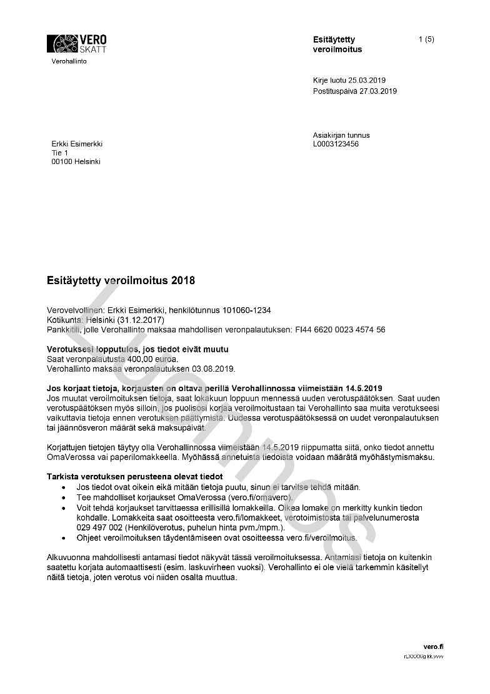
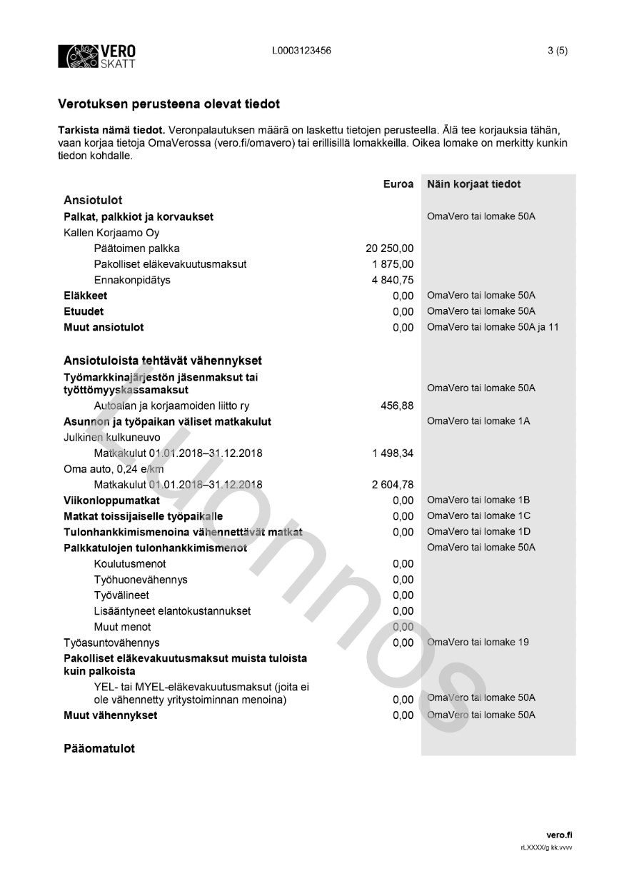
The return looks like this:
Veronpalautuksen tai jäännösveron määrä ja maksupäivä
Tarkista, että
tulot ja vähennykset
ovat oikein
Päivä, jolloin korjaukset pitää viimeistään tehdä

Slide 13
Tax Return on the Web
Log in to make corrections
  Tax Return on the Web (vero.fi/veroilmoitus)
  The last date to make corrections
  is the date printed on your paper return form.
Run the Demo version to practice
  Demo

Slide 14

Tax decision
2020
The Pre-completed tax return is enclosed
with a Tax decision (first version).
  If there is no need to make corrections,
  the first version becomes the final version.
  If you make corrections, a new Tax decision
  is sent to you in the autumn.
Tax decision shows you: will you get
money back, or will you have to pay more.
Keep the papers.

Slide 15

About Refunds and Back Taxes
2020
If you overpaid tax during the year,
you will receive a refund in December
the following year.
  Make an online bank account number
  notice for refunds (vero.fi/tilinumero)
If you paid too little, you must pay more
in December the following year (back tax).
  The bank transfer forms
  are sent to you together with
  your Tax decision.

Slide 16
Taxes can be reduced by deductions
You may ask for deductions
which reduce the tax
you have to pay.
Some deductions are
automatically calculated
by the Tax Office.

Slide 17
Taxes can be reduced by deductions
Travel expenses give you a deduction, but you must ask for it.
We recommend that you inform us
about your deductions. Do this when
you check your tax return or ask for
a new tax card.
More about deductions (www.tax.fi)

